Slide 1


Object Detection using TensorFlow Lite Raspberry Pi 4 4GB + PiCamera
Simon Chu

Slide 2
Introduction
The purpose of the project is to develop Object Detection with TensorFlow Lite utilizing prepared data (pictures and annotation). The intent is to have real-time detection of objects with available hardware (e.g. camera or webcam).
Utilizing a Raspberry Pi 4 and a PiCamera was utilized for the hardware aspect for object detection.
For software, TensorFlow Lite, OpenCV, and Python 3 was utilized to develop the real-time identification of objects.
The most impressive aspect of this event is the ease of creating a real-time detection application APIs from TensorFlow and the ability to utilize it with a Raspberry Pi 3B+ or 4.
https://github.com/schu-lab/TensorFlow-Object-Detection

Slide 3
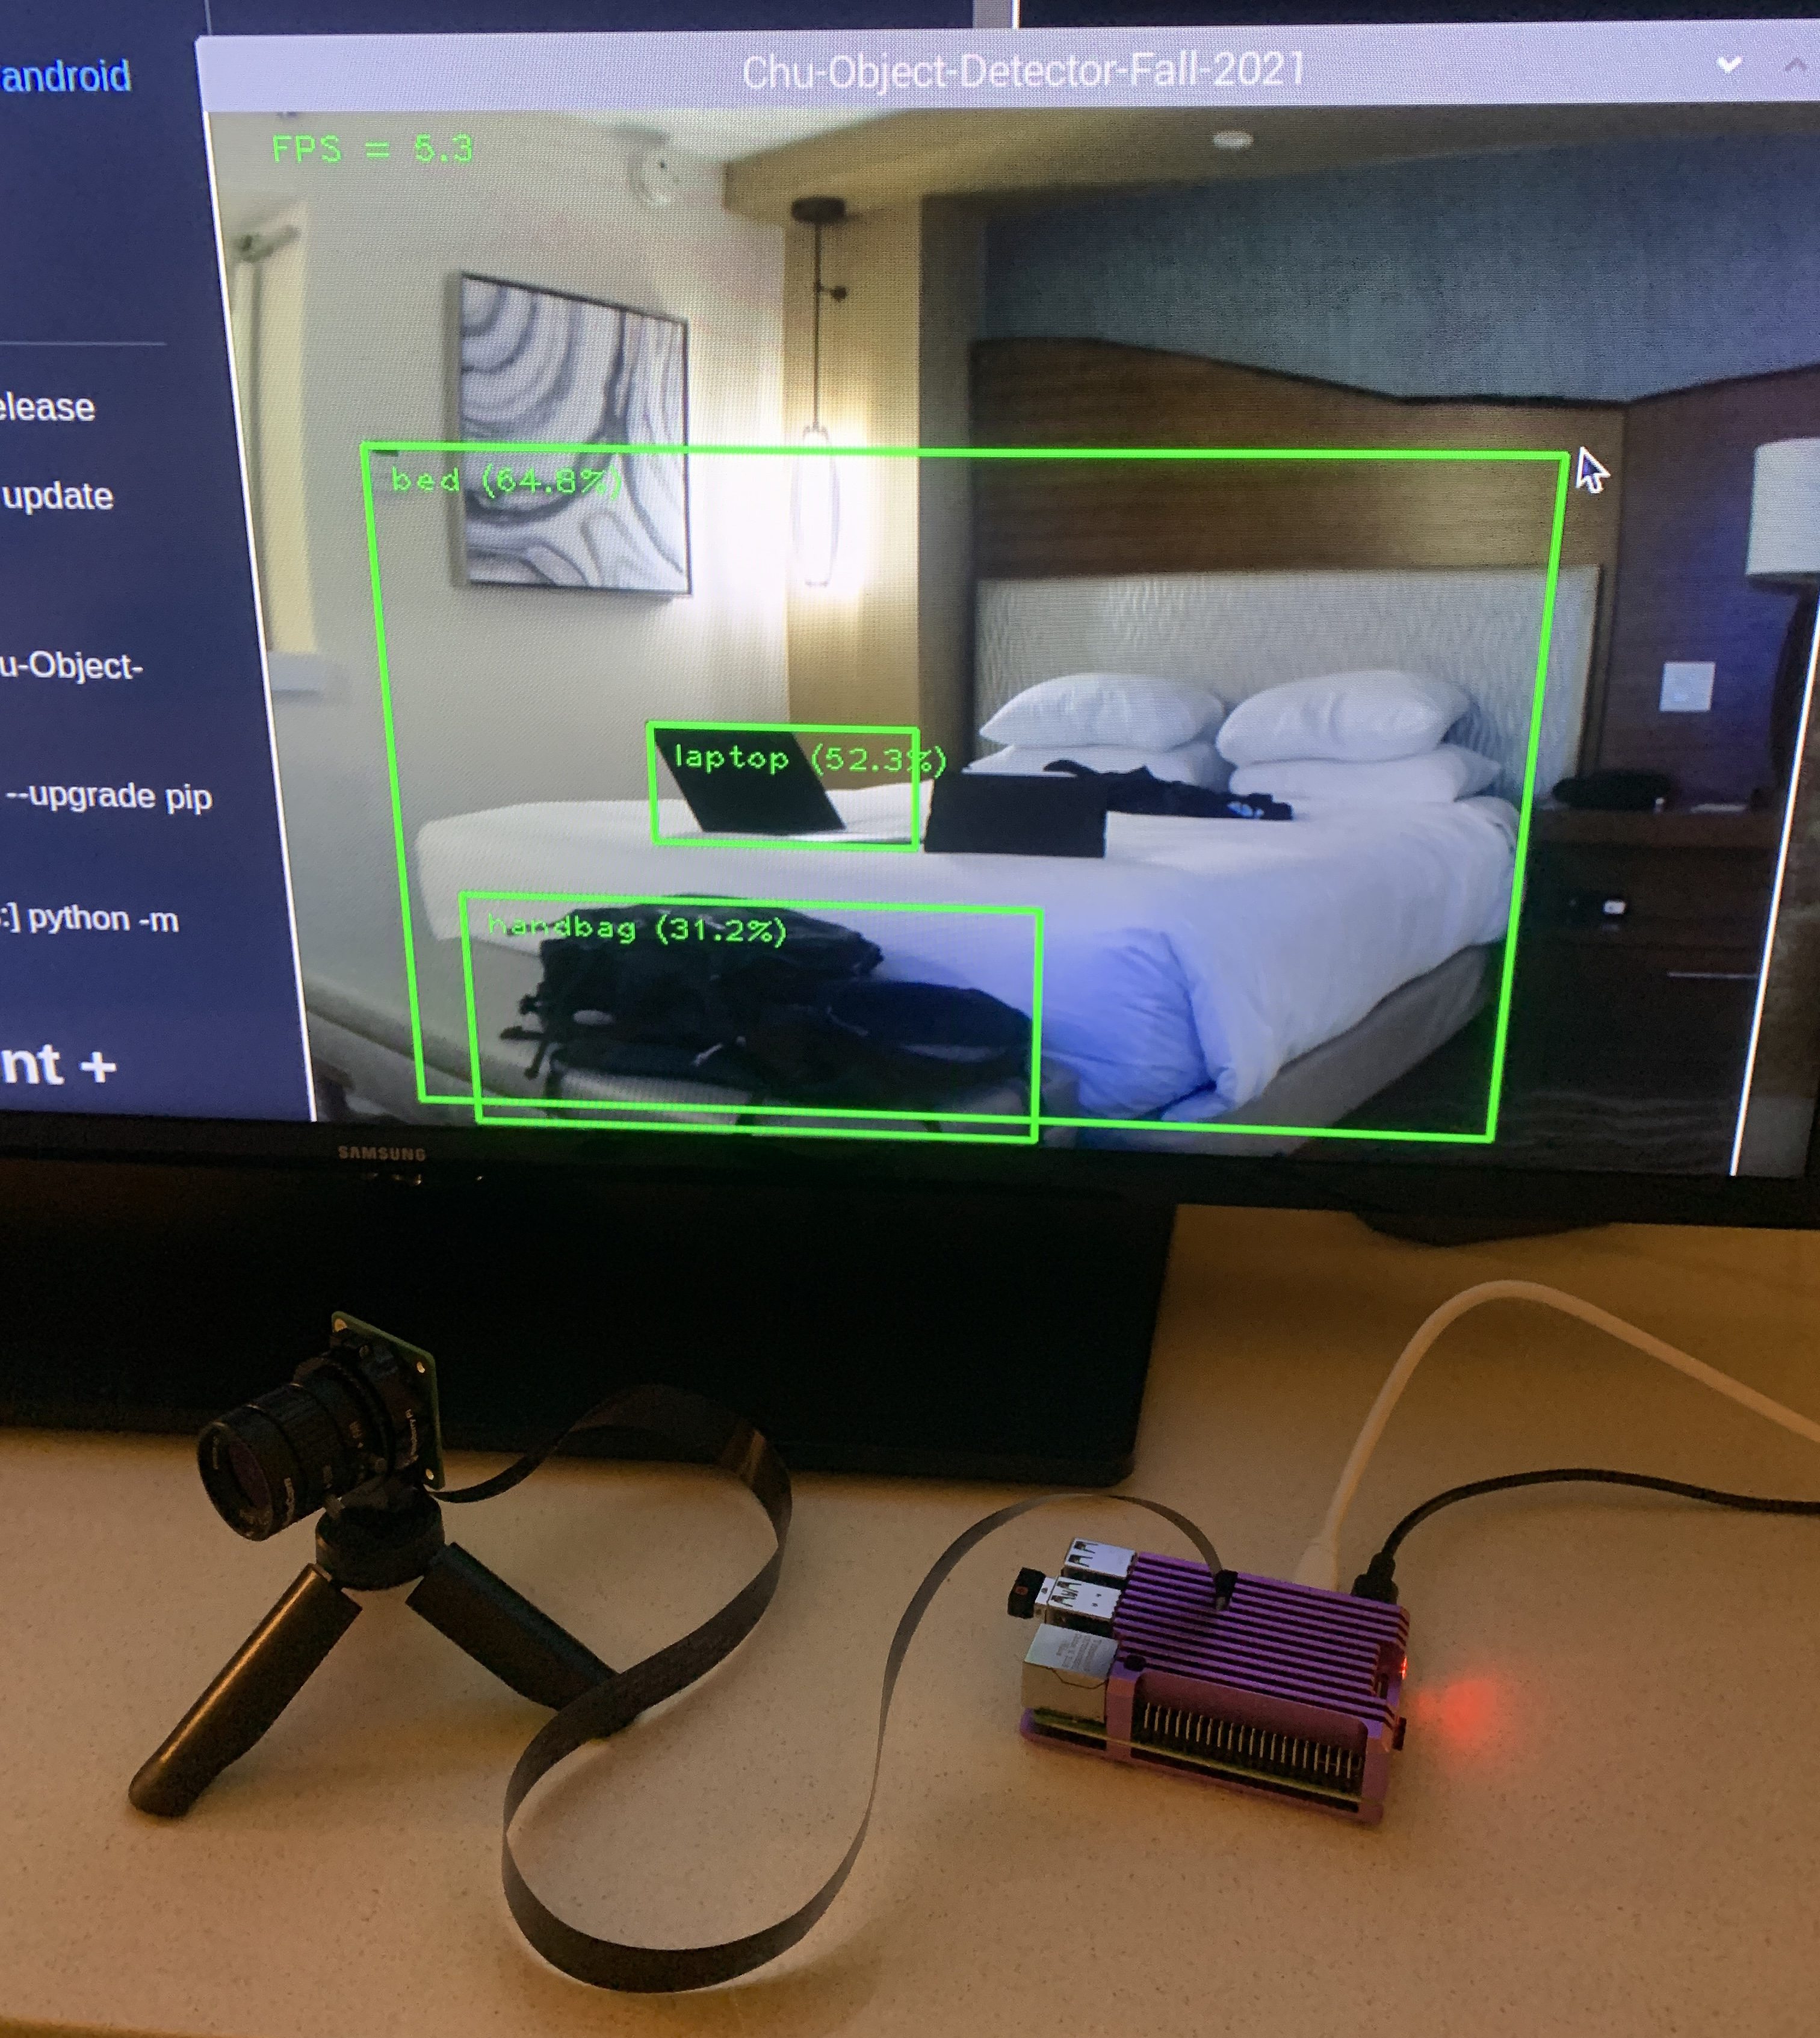

Hardware Required
Raspberry Pi 4 – 4GB
PiCamera 2018 v1.0
6mm CS Lens
Portable Tripod

Slide 4



Software Required
Python 3
TensorFlow Lite
OpenCV

Slide 5
Datasets:
TensorFlow Lite Pre-trained Model
Handgun Images: https://sci2s.ugr.es/sites/default/files/files/TematicWebSites/WeaponsDetection/BasesDeDatos/WeaponS.zip
Handgun Annotation: https://sci2s.ugr.es/sites/default/files/files/TematicWebSites/WeaponsDetection/BasesDeDatos/WeaponS_bbox.zip
Android Toys Data Set - .jpg + .xml (Pascal VOC): https://storage.googleapis.com/download.tensorflow.org/data/android_figurine.zip

Slide 6
Demo
Location: Room
Note the Boundary Box with Object Label and Confidence/Accuracy

Slide 7
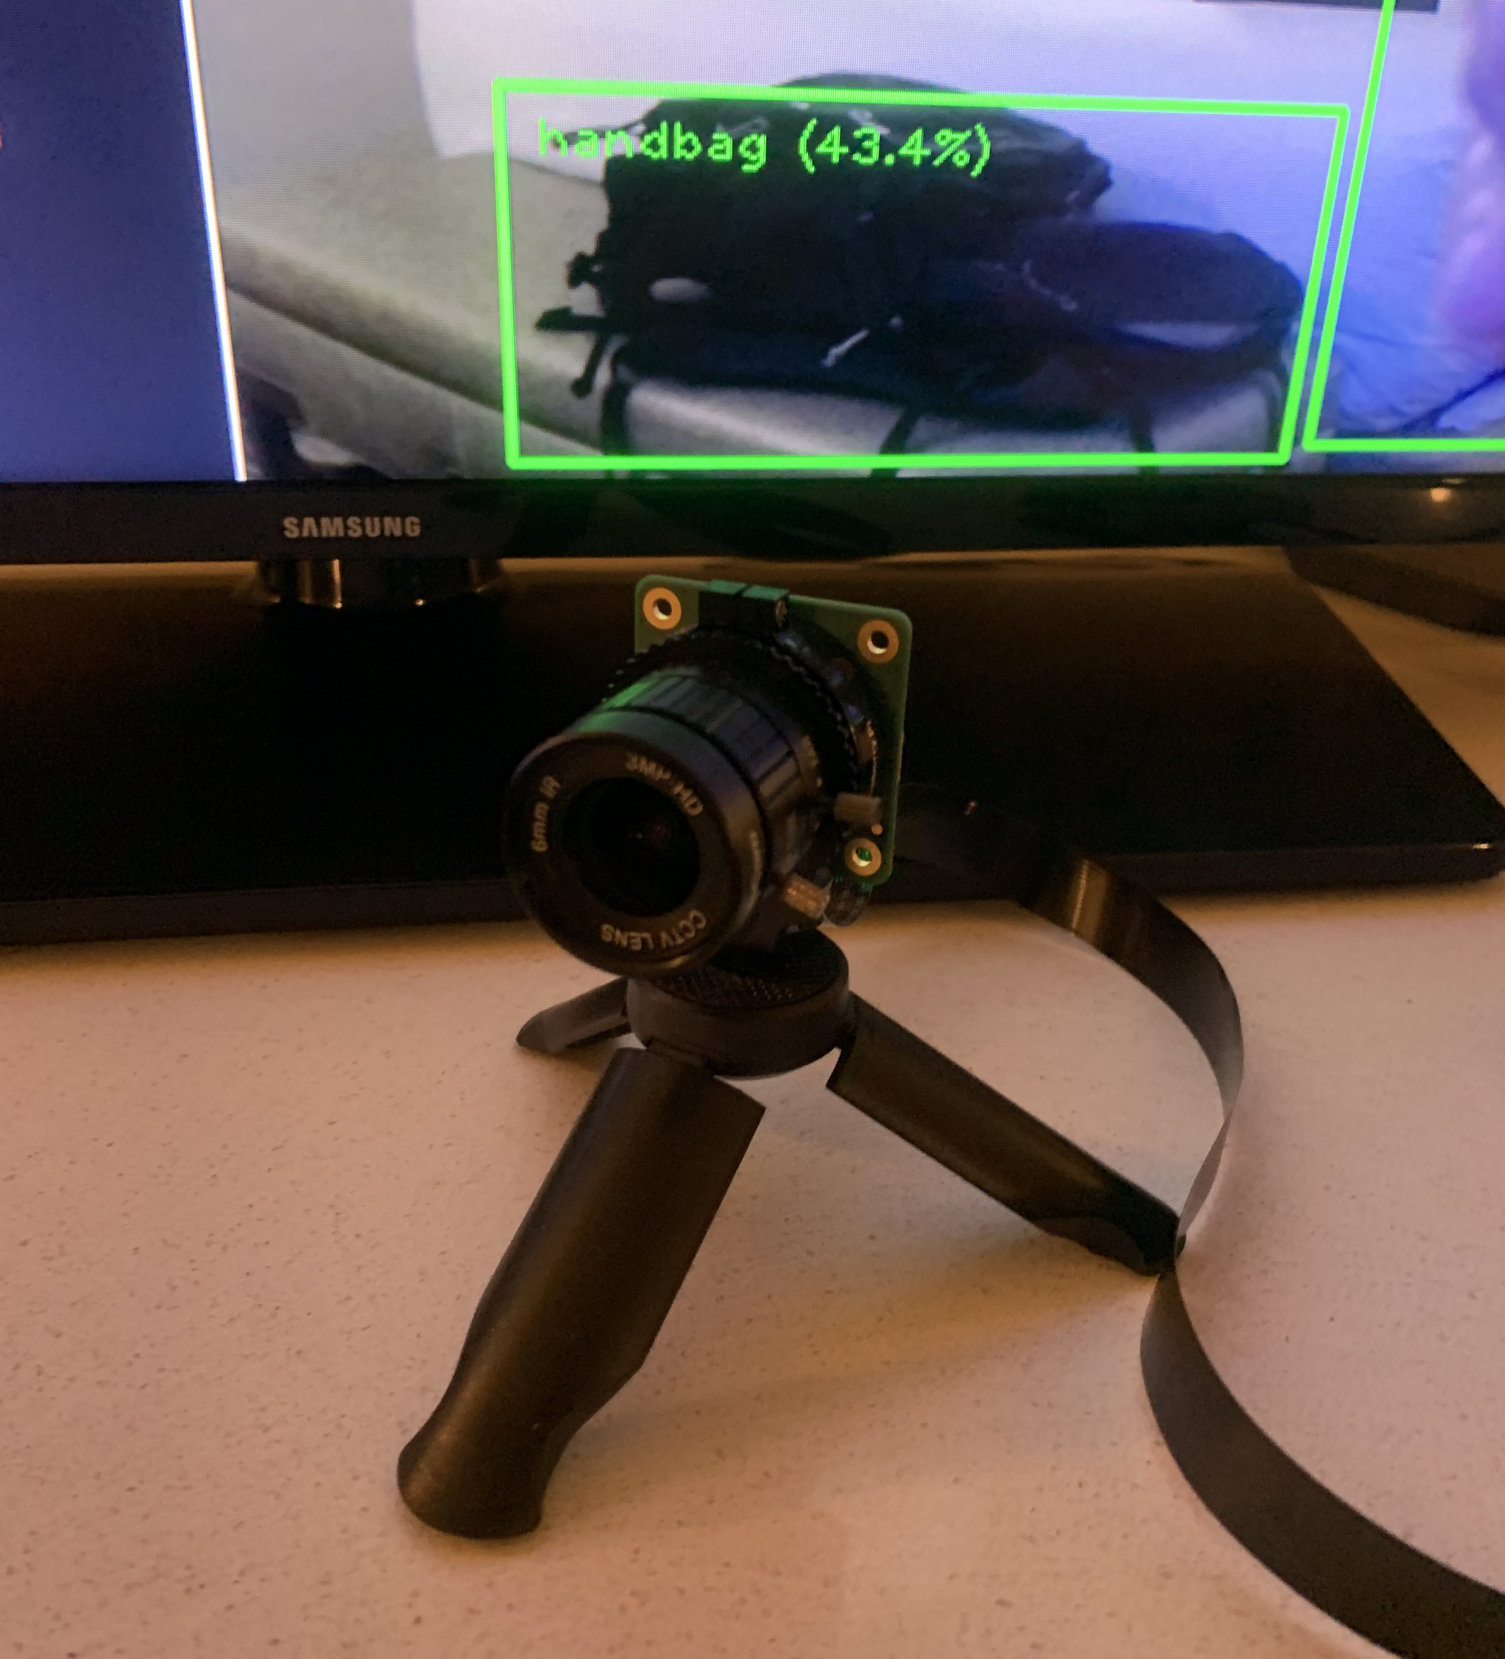
How it works:
OpenCV used to capture images from the PiCamera
Initialize TensorFlow Lite Object Detection Model
Captures the frames continues from the camera and repeats the frame to the object detector.
Creates visualization boundary boxes and confidence scores

Slide 8
Training an object detection model
Create a training data set
Collect images and labeling (Most effort / time-consuming step)
Train a custom model
Use Tensorflow Lite Model Maker - https://colab.research.google.com/github/khanhlvg/tflite_raspberry_pi/blob/main/object_detection/Train_custom_model_tutorial.ipynb
Deploy the model
Use on Raspberry Pi by replacing a custom model

Slide 9
Step 1: Create a training dataset
Use LabelImg (Open Source App) to draw a boundary box and label
Draw a boundary box and label it
The more images you collect, the better the accuracy.
Training Images - 80% of your dataset – Used to train model
Test Images – 20% of your dataset – Used later to evaluate model

Slide 10
Step 2: Use Model Maker Object Detection
Use TensorFlow Lite Model Maker Object Detection utilizing dataset
https://colab.research.google.com/github/khanhlvg/tflite_raspberry_pi/blob/main/object_detection/Train_custom_model_tutorial.ipynb
Load the Dataset
Choose Model Architecture
EfficientDet-Lite0 to EfficientDet-Lite4
Train the TensorFlow model with the training data
Evaluate the model with validation data
Look at Average Precision (AP)
Export as a TensorFlow Lite Model
Evaluate the TensorFlow Lite Model

Slide 11
Step 3: Deploy the Model
Download the TFlite model
Download new tflite model and move to working folder
Run the python script
‘python Chu-Object-Detection-Fall-2021.py --model ‘test.tflite’

Slide 12
References
https://sci2s.ugr.es/weapons-detection
https://github.com/tensorflow/examples
https://www.digikey.com/en/maker/projects/how-to-perform-object-detection-with-tensorflow-lite-on-raspberry-pi/b929e1519c7c43d5b2c6f89984883588
https://colab.research.google.com/github/khanhlvg/tflite_raspberry_pi/blob/main/object_detection/Train_custom_model_tutorial.ipynb
https://dasci.es/transferencia/open-data/24705/
https://github.com/tzutalin/labelImg
[https://sci2s.ugr.es/sites/default/files/files/TematicWebSites/WeaponsDetection/BasesDeDatos/WeaponS.zip
https://sci2s.ugr.es/sites/default/files/files/TematicWebSites/WeaponsDetection/BasesDeDatos/WeaponS_bbox.zip
https://storage.googleapis.com/download.tensorflow.org/data/android_figurine.zip

